Slide 1

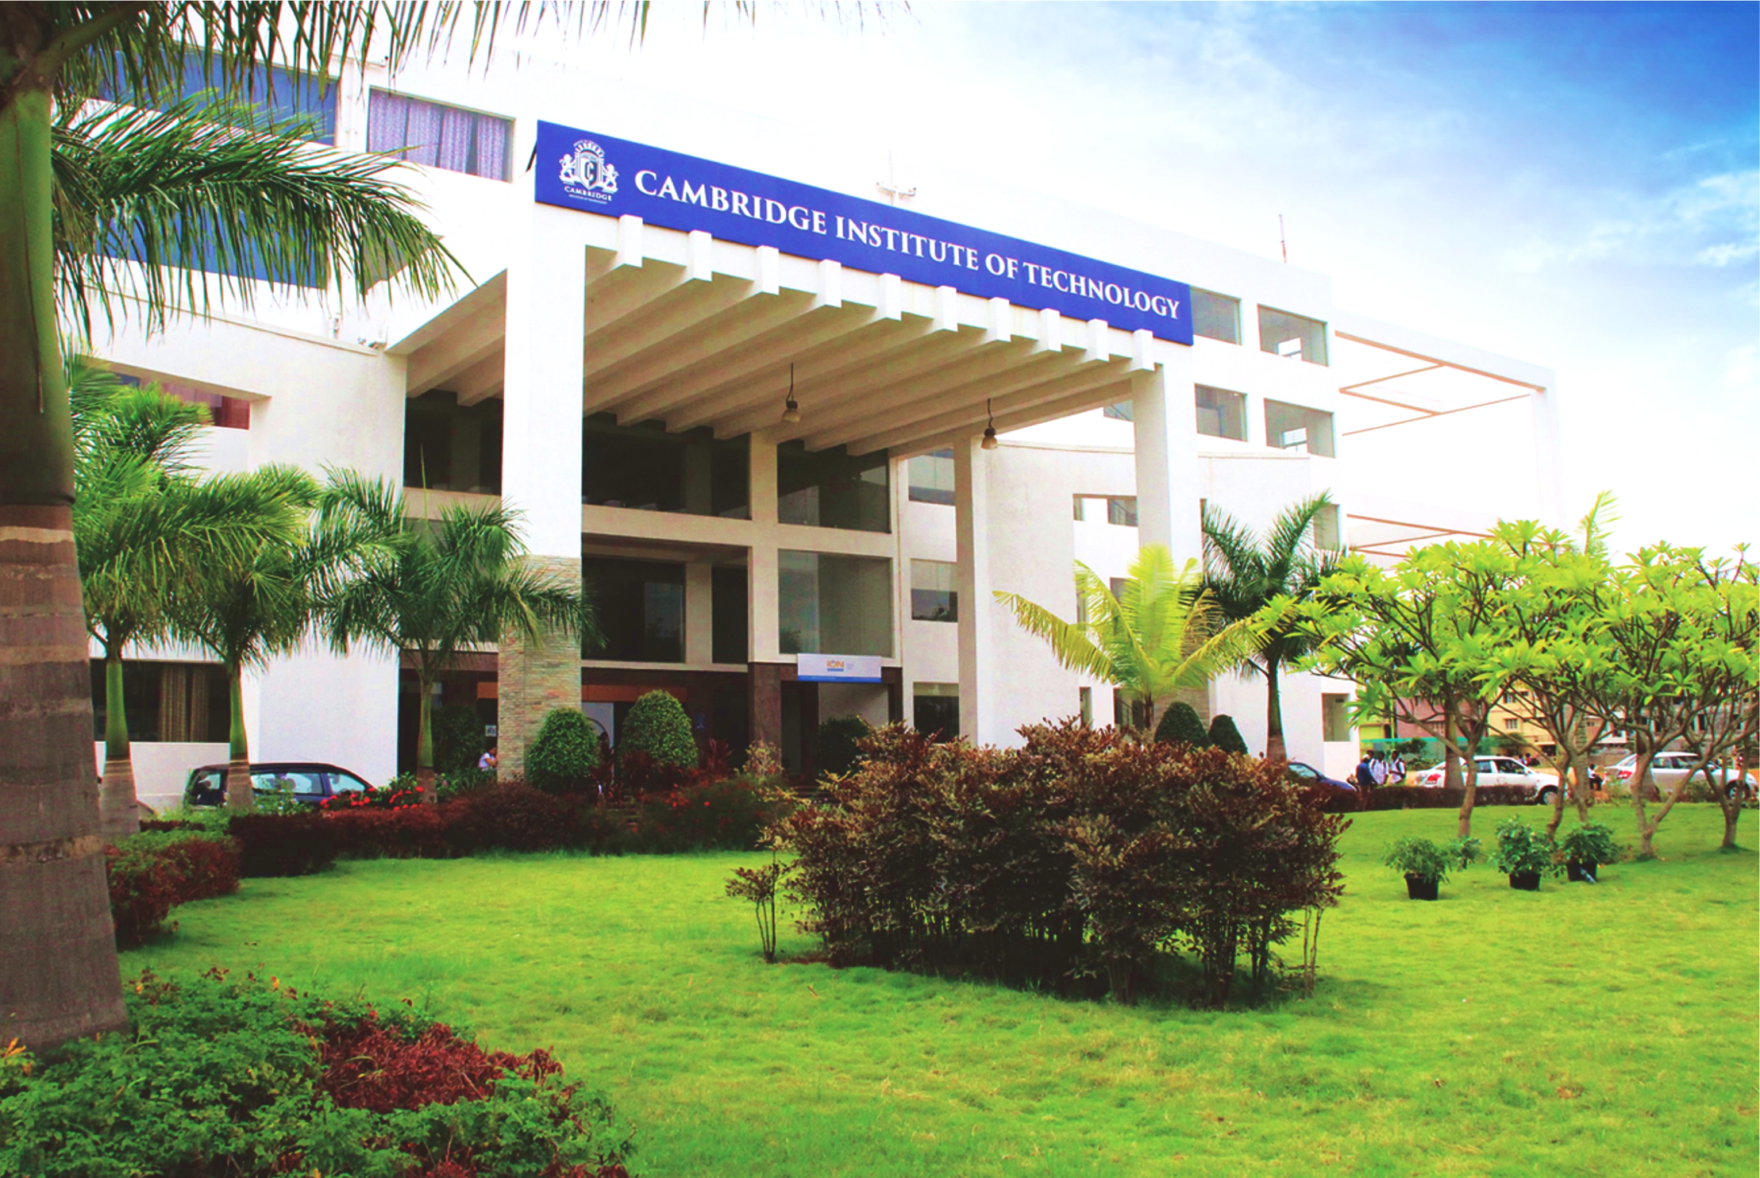
www.cambridge.edu.in
Machine Learning
Subject Code:21AI63
Project Name: Pneumonia detection
Using Deep Learning
Presented By :
Gajendra C 1CD21AI015
Sandeep John R 1CD21AI051
Department of Artificial Intelligence and Machine Learning

Slide 2
Introduction
Pneumonia is a critical respiratory infection traditionally diagnosed through clinical evaluation and chest X-rays. This paper explores how deep learning, especially convolutional neural networks (CNNs), can automatically and accurately detect pneumonia from medical images, supporting radiologists and enhancing diagnostic speed and accuracy. Integrating these systems into clinical practice promises improved patient care and outcomes.
Why:
By creating a powerful CNN model to spot pneumonia in X-ray images, we can significantly improve how doctors diagnose this disease. A CNN can examine X-rays much faster than a human, helping doctors make decisions quicker. This speed is crucial because early detection of pneumonia is key to successful treatment.
Department of Artificial Intelligence and Machine Learning www.Cambridge.edu.in

Slide 3
Literature Survey
SL NO | PAPER TITLE | JOURNAL NAME | DESCRIPTION | PROS | CONS
1 | ChexNet: Radiologist-Level Pneumonia Detection on Chest X-Rays with Deep Learning | arXiv preprint arXiv:1711.05225 | This paper presents a deep learning algorithm, CheXNet, which surpasses radiologist performance in detecting pneumonia from chest X-rays. It uses a 121-layer convolutional neural network trained on a large dataset of chest X-ray images. | Extensive review of current technologies, practical applications, and future research directions. | May be highly technical, requiring a background in signal processing and machine learning.
2 | Deep Learning for Chest Radiograph Diagnosis: A Retrospective Comparison of the CheXNeXt Algorithm to Practicing Radiologists | PLOS Medicine | This study compares the performance of the CheXNeXt algorithm with practicing radiologists in diagnosing various thoracic diseases, including pneumonia, using chest radiographs. | Comprehensive comparison with human experts, demonstrates practical application.. | Limited to retrospective data, potential biases in radiologist interpretations..
Department of Artificial Intelligence and Machine Learning www.Cambridge.edu.in

Slide 4
SL NO | PAPER TITLE | JOURNAL NAME | DESCRIPTION | PROS | CONS
3 | Development and Validation of a Deep Learning Algorithm for Detection of Diabetic Retinopathy in Retinal Fundus Photographs | JAMA | While not specific to pneumonia, this paper demonstrates the application of deep learning in medical image analysis, providing insights applicable to pneumonia detection methodologies.. | Demonstrates successful clinical application, detailed methodology... | Focuses on diabetic retinopathy, requiring adaptation for pneumonia detection.
4 | A Deep Learning Algorithm for Automated Detection of COVID-19 from Chest X-rays | Nature Communications | This paper details the development of a deep learning algorithm designed to detect COVID-19 pneumonia from chest X-rays, showcasing its potential in rapid and accurate diagnostics. | High relevance due to the COVID-19 pandemic, demonstrates rapid deployment potential. | COVID-19 specific, may require adaptation for general pneumonia detection..
Department of Artificial Intelligence and Machine Learning www.Cambridge.edu.in

Slide 5
Problem Statement
"Enhancing Pneumonia Diagnosis through Deep Learning-Based Automated Chest X-Ray Analysis"
Department of Artificial Intelligence and Machine Learning www.Cambridge.edu.in

Slide 6
Abstract
Pneumonia is a severe respiratory illness demanding rapid and accurate diagnosis for optimal patient care. Traditional diagnostic methods, combining clinical assessment and radiologist-interpreted chest X-rays, are often time-consuming and prone to inconsistencies. This study explores the use of deep learning, specifically convolutional neural networks (CNNs), to automate pneumonia detection from chest X-ray images. We developed a CNN model trained on a substantial dataset of labeled X-rays to match or surpass the diagnostic capabilities of human experts. Our findings demonstrate that this model can significantly accelerate and enhance diagnostic precision, reducing the burden on healthcare professionals while providing consistent and objective assessments. Integrating this technology into clinical practice has the potential to improve patient outcomes, enable timely interventions, and reduce healthcare costs, marking a significant advancement in medical image analysis.
Department of Artificial Intelligence and Machine Learning www.Cambridge.edu.in

Slide 7
Objectives :
The few objectives approach are mentioned below :-
Develop a Robust Deep Learning Model: Create and fine-tune a convolutional neural network (CNN) capable of accurately detecting pneumonia from chest X-ray images.
Evaluate Diagnostic Accuracy: Assess the performance of the deep learning model by comparing its accuracy with that of experienced radiologists using a diverse set of chest X-ray datasets.
Enhance Diagnostic Speed: Design an intuitive and user-friendly interface that can be easily navigated by individuals with minimal technical knowledge.
Improve Consistency in Diagnoses: Ensure consistent and objective evaluations by minimizing the variability associated with human interpretation.
Promote Accessibility and Scalability:Develop a solution that is scalable and accessible to healthcare facilities globally, especially in resource-limited settings where access to expert radiologists may be limited.
Department of Artificial Intelligence and Machine Learning www.Cambridge.edu.in

Slide 8
System Architecture
Front-End:
Intuitive user interface for X-ray input and Analysis to final output.
Language Models:
Powerful neural networks trained on vast image data set
Deployment and integration:
API to allow integration with hospital information systems (HIS) and Picture Archiving and Communication Systems (PACS).
Department of Artificial Intelligence and Machine Learning www.Cambridge.edu.in

Slide 9
Methodology
Data Collection and Preprocessing: Gather large datasets of annotated chest X-ray images from public sources and medical institutions.
Model Development: Select and design a convolutional neural network (CNN) architecture suitable for image classification.
Training and Validation: Train the model using binary cross-entropy loss and optimization algorithms (e.g., Adam, SGD), and validate performance with metrics like accuracy, precision, recall, F1 score, and AUC-ROC.
Model Evaluation: Compare the model's diagnostic performance against expert radiologists. Compare the model's diagnostic performance against expert radiologists.
Deployment and Integration: Develop an API and user interface for seamless integration into hospital systems. Ensure real-time processing capabilities and continuously monitor and update the model based on clinical feedback and new data, while maintaining data privacy and security compliance.
Department of Artificial Intelligence and Machine Learning www.Cambridge.edu.in

Slide 10
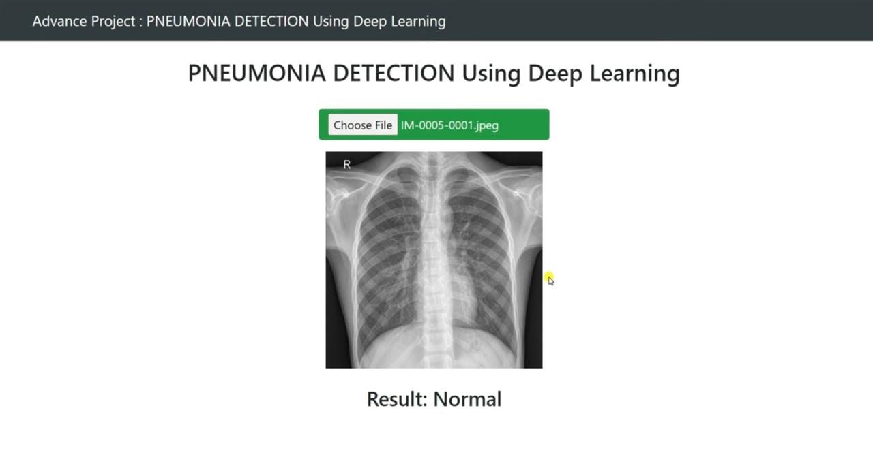
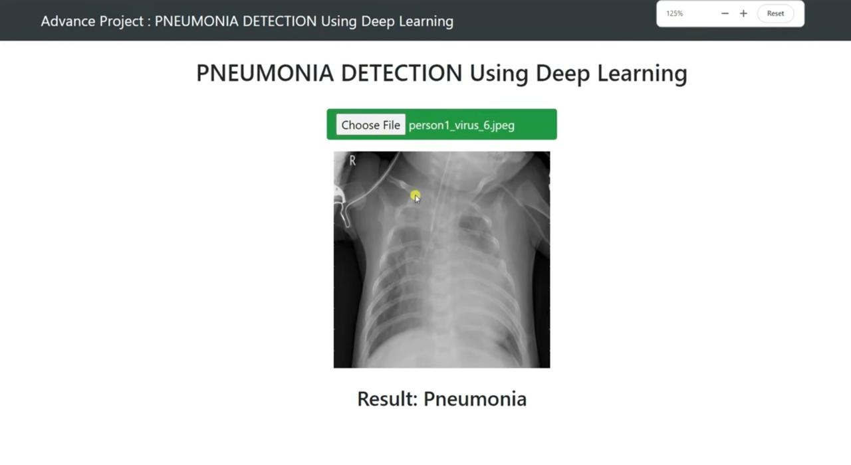
Results :
Department of Artificial Intelligence and Machine Learning www.Cambridge.edu.in

Slide 11
Conclusion
This study demonstrates the effective use of deep learning, particularly convolutional neural networks (CNNs), for detecting pneumonia from chest X-ray images. By employing transfer learning and rigorous training, our model achieved diagnostic accuracy on par with experienced radiologists. This approach addresses traditional diagnostic challenges by providing faster, more consistent, and objective analyses. The system's deployment promises enhanced diagnostic speed, reduced workload for healthcare professionals, and timely patient interventions, leading to better outcomes. Integration into hospital systems, along with continuous monitoring and updates, ensures sustained performance. Future work will expand datasets, enhance model accuracy, and explore broader applications. This advancement in medical image analysis holds the potential to transform clinical diagnostics and improve healthcare delivery..
Department of Artificial Intelligence and Machine Learning www.Cambridge.edu.in

Slide 12
Future Enhancement:
Expand Dataset Diversity: Collect and integrate more diverse and comprehensive datasets, including images from various demographics and different healthcare settings, to improve the model's generalizability.
Multimodal Data Integration: Incorporate additional data types such as clinical notes, patient history, and laboratory results to enhance the model's diagnostic capabilities and provide a more holistic assessment.
Improved Model Architectures: Explore and implement more advanced deep learning architectures, such as attention mechanisms, transformer models, or hybrid models combining CNNs and recurrent neural networks (RNNs), to further improve accuracy and interpretability.
Explainability and Transparency: Develop methods to increase the explainability of the model's predictions, such as using attention maps or saliency maps, to help clinicians understand and trust the model's decision-making process.
Real-Time Feedback and Learning: Implement a system for real-time feedback from radiologists, allowing the model to continuously learn and adapt from new cases and corrections provided by healthcare professionals.

Slide 13
References
1. CheXNet: Radiologist-Level Pneumonia Detection on Chest X-Rays with Deep Learning Author: Pranav Rajpurkar, Jeremy Irvin, Kaylie Zhu, Brandon Yang Published In: arXiv preprint arXiv:1711.05225 Publication Year: 2017 Description: This paper presents CheXNet, a deep learning model trained on a large dataset of chest X-ray images to detect pneumonia with an accuracy surpassing that of radiologists. The model is based on a 121-layer convolutional neural network and demonstrates the potential of deep learning in medical image analysis.
2. Deep Learning for Chest Radiograph Diagnosis: A Retrospective Comparison of the CheXNeXt Algorithm to Practicing Radiologists
Author: Tony Duan, Daisy Ding, Aarti Bagul, Curtis Langlotz, Katie Shpanskaya Published In PLOS Medicine
Publication Year: 2018 Description: This study compares the performance of the CheXNeXt deep learning algorithm with practicing radiologists in diagnosing multiple thoracic diseases, including pneumonia, using chest radiographs.
Department of Artificial Intelligence and Machine Learning www.Cambridge.edu.in

Slide 14
THANK YOU
Department of Artificial Intelligence and Machine Learning www.Cambridge.edu.in

